Slide 1
Solution Specification
Lecturer: Ngo Huy Bien
Software Engineering Department
Faculty of Information Technology
VNUHCM - University of Science
Ho Chi Minh City, Vietnam
nhbien@fit.hcmus.edu.vn

Slide 2

Objectives
To create a prototype.
To create an architecture.
To create a solution sketch.
To create a proof of concept.
To create a CI/CD/DevOps scripts.
To create and operate Kanban board.
To create project estimate.

Slide 3

Contents
Prototype.
Architecture.
Evaluation Approach.
Expected Products.
CI/CD/DevOps Tools.
Kanban.
Estimation.

Slide 4

References

Slide 5
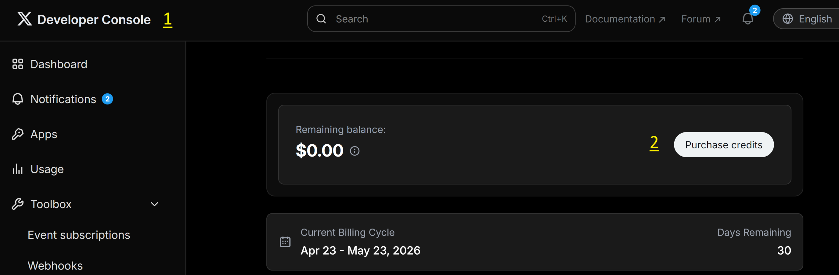
1. Prepare Services

Slide 6

1. Build Prototype

Slide 7


2. Create Architecture
4+1 View Model
Functional (Logical) (Diagram)
Development (Project Structure) (Code)
Programming Languages
Technologies and Tools
Deployment (Servers) (Diagram)
Process (Diagram)
(Use cases/Scenarios)
Security view.
Storage (Data Models) (Diagram)

Slide 8
AI Agents and Architecture
Architecture does not always need to be designed first.
It can emerge from implementation or generation processes.
Important inputs: technology stacks + architectural patterns.

Slide 9
Why Derive Architecture from Code?
The primary value of architecture today often lies in analysis, evaluation, and refinement, rather than solely in upfront design.
System Understanding
Evaluating Non-Functional Properties
Refining Structural Patterns

Slide 10
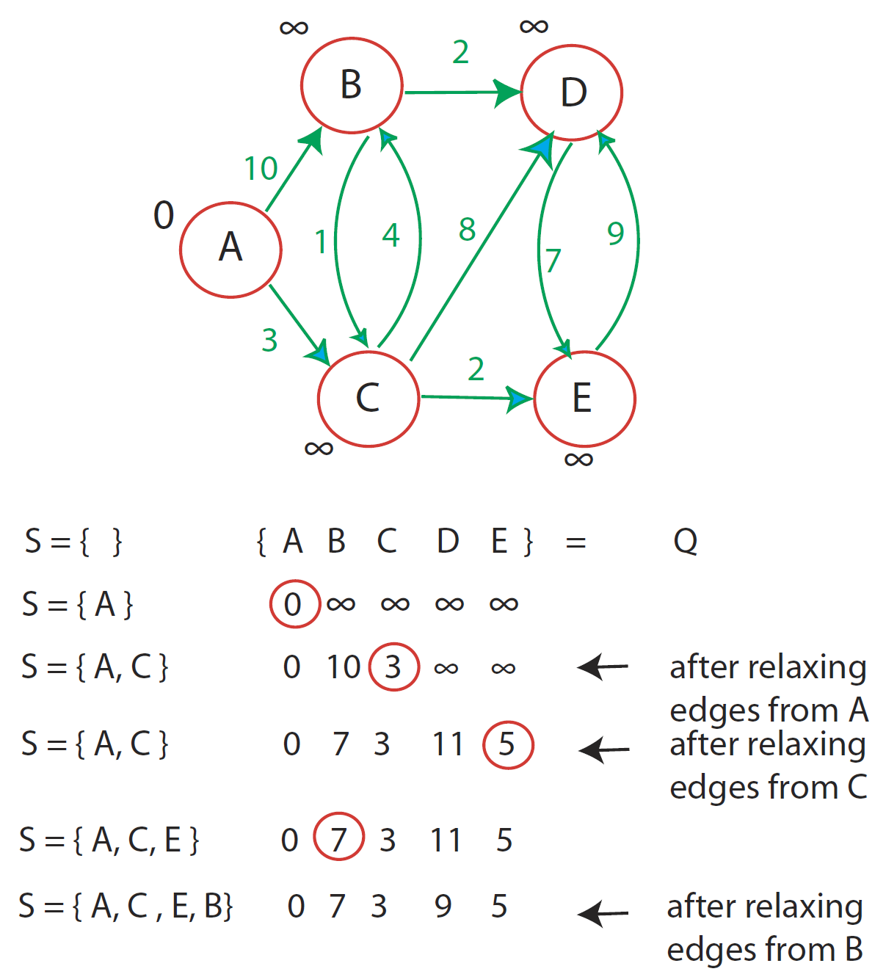
3. Select and Explain Algorithms
This step is required for complex features.
Typical artifact: Flowcharts.

Slide 11

4. Create Solution Sketch
Development Architecture
Programming Languages (Go, JavaScript)
Frameworks, Libraries, APIs/Services, Platforms, SDKs, Tools
Source Code

Slide 12

5. Create Proof of Concept
Solution Sketch
→ A difficult feature implementation.

Slide 13
6. Select Evaluation Approach
The testing objectives that are expected to be performed on the system:
Functionality
UI/UX
Load testing, security testing, stress testing.
The comparison and evaluation methods for the system against similar systems:
Feature comparison table
User surveys based on the problem to be solved.

Slide 14
7. List Expected Products
The expected products to be obtained. These products may include, but are not limited to, the following:
Mobile application source code,
Web application source code,
Web service source code,
Newly generated data,
Test result reports,
Survey data,
Comparison report with a similar system,
Technical documentation detailing the method for reproducing the products.

Slide 15


8. Review Technical Solution
User stories (WHAT), use cases (HOW), story map (HOW), prototypes (WHAT + HOW).
Architecture & Design.
Programming Languages.
Technologies and Tools.

Slide 16


Slide 17
1. Establish CI/CD/DevOps Tools
GitHub Actions. https://github.com/features/actions
GitLab. https://about.gitlab.com/
CircleCI. https://circleci.com/
Travis CI. https://travis-ci.org/

Slide 18
2. Select Methods and Processes
Scrum/Kanban/RUP/Waterfall
Scrum: 2 weeks: Release → Solving a SMALL problem.
Kanban: flexible iteration: Release → Solving a SMALL problem.
Tools (Task Management, Time Tracking).
Management (Estimation/Motivation)

Slide 19
Kanban-style Estimation
Complete the work (user stories) within 1 week.
Track completed work via AI to determine percent complete.
Estimate the remaining effort based on weighted story completion.
Caveat: Kanban works best when story sizes are relatively uniform or weighted appropriately.

Slide 21

ML Product Solution Specification
The models expected to be applied or improved.
The existing data sources and source code expected to be used for training.
The GPU resources intended to be used.
The experimental results of training and inference using the existing source code and dataset.

Slide 22

Thank You & See You Again

